Slide 1
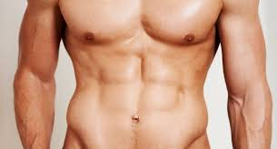
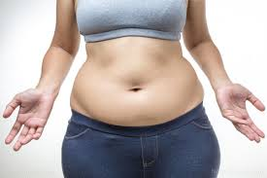
Abdominal circumference v.s body fat
Group 17: Nan Yang, Crystal Liu, Sukyoung cho

Slide 2
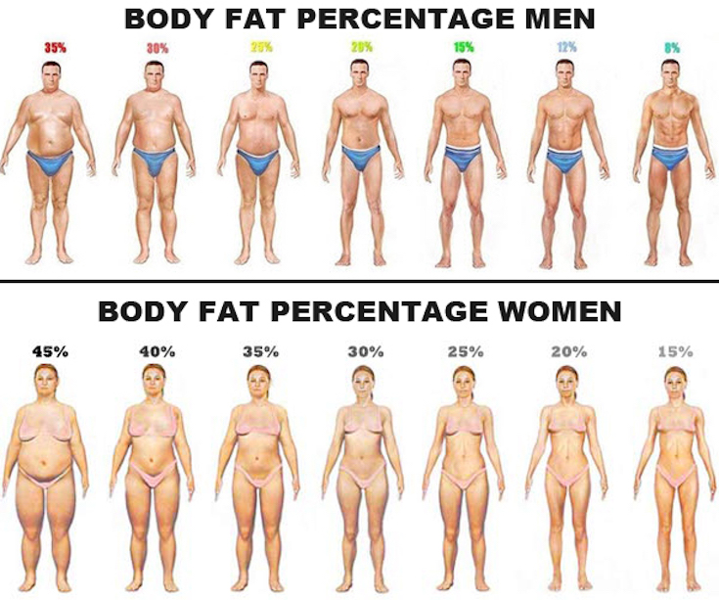
The body fat percentage (BFP) of a human or other living being is the total mass of fat divided by total body mass, multiplied by 100.

Slide 3
Dataset
The data set contains measurements from 252 men who had their body fat percentage accurately measured via underwater weighing.
17 Varaible:
IDNO;
BodyFat(%) ------ Y (the outcome)
Which one is the best predictor?
Age (years) ; Weight (lbs) ; Height (inches) ; Adioposity (bmi) ; Neck circumference (cm)
Chest circumference (cm) ; Abdomen 2 circumference (cm) ; Hip circumference (cm)
Thigh circumference (cm) ; Knee circumference (cm) ; Ankle circumference (cm)
Biceps (extended) circumference (cm) ; Forearm circumference (cm) ; Wrist circumference (cm)

Slide 4
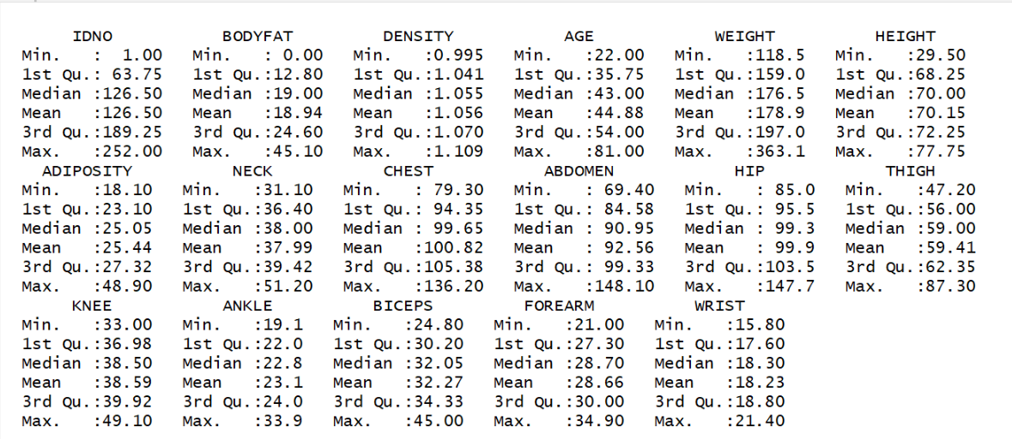
Analyze Data
SAME PERSON!

Slide 5
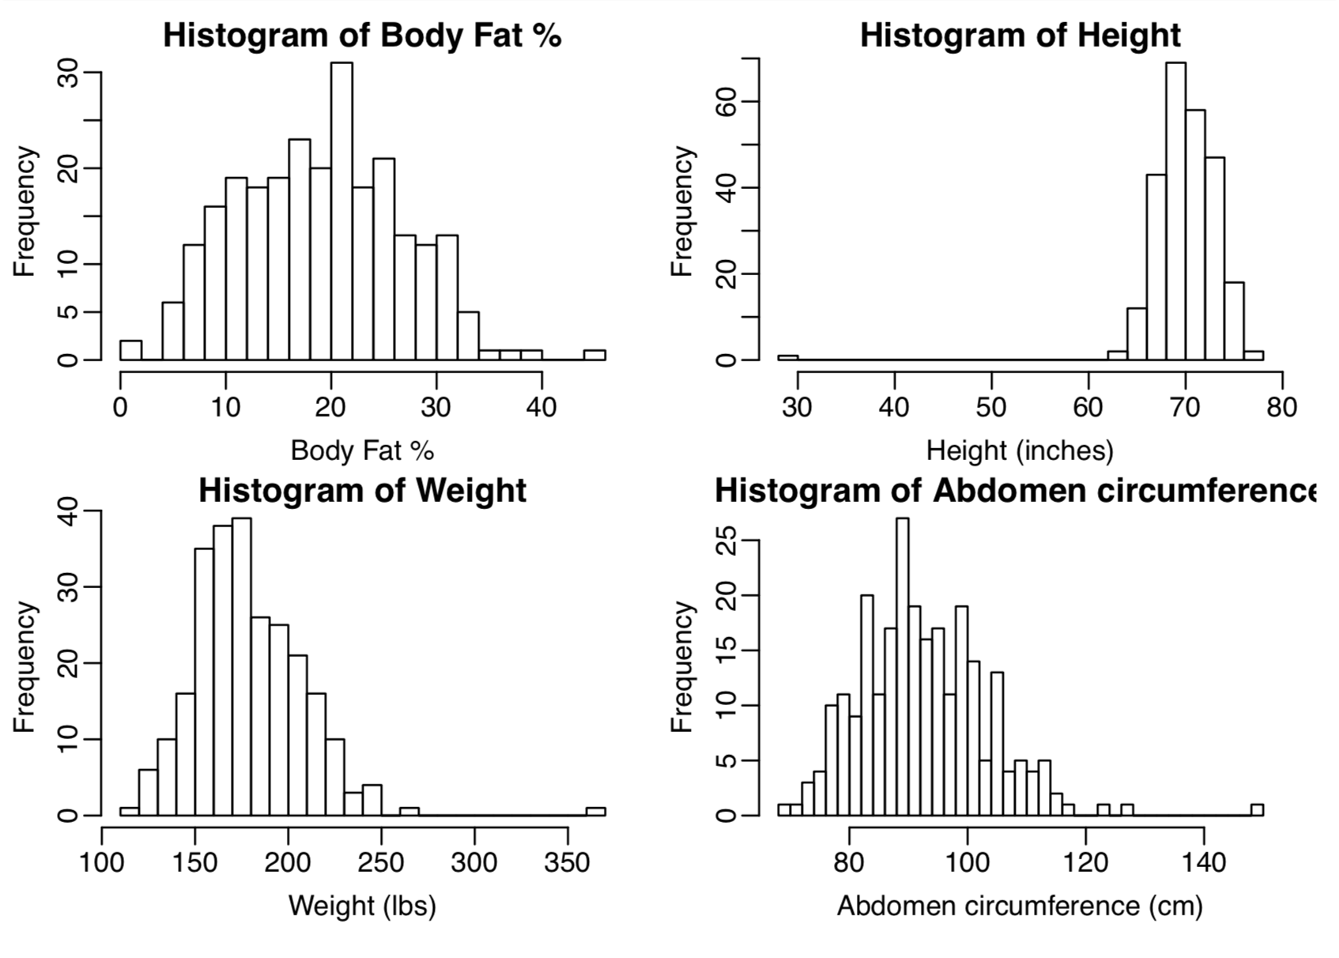

Slide 6
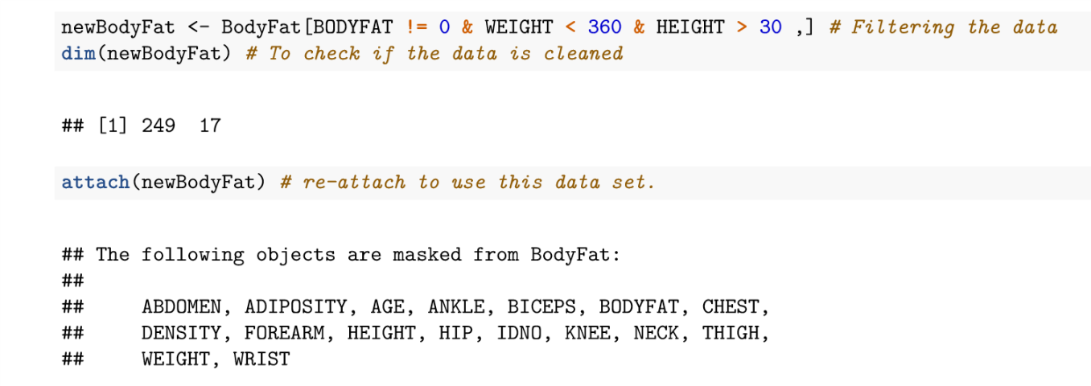

Slide 7
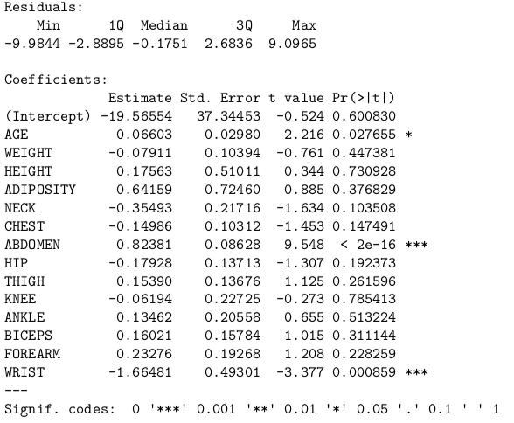
Choose the best predictor
Highest multiple R-squared
Multiple linear model with all variables
summary of the model
choose abdominal circumferences

Slide 8
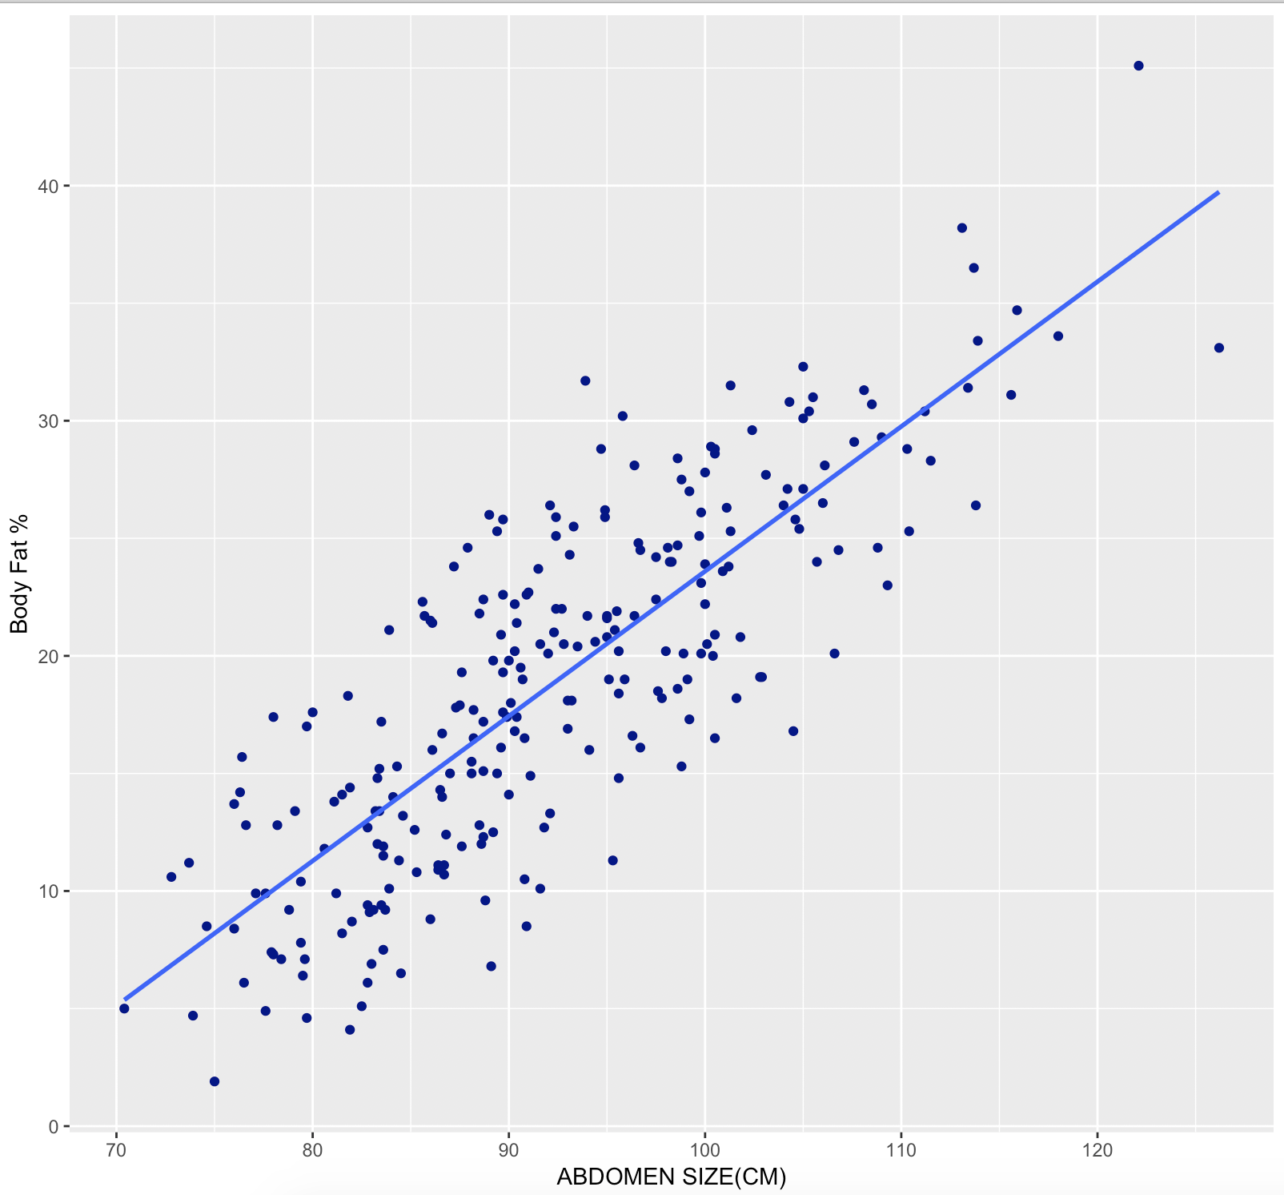
SLR model: Yi= β0 + β1Xi + εi, εi∼N(0,σ2)
independent variable(x)
Abdominal circumferences
unit: cm
dependent variable(y)
body fat
unit: %

Slide 9
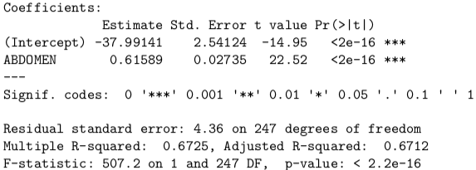

Body fat (%) = -37.991 + 0.616*abdomen circumference
intercept = -37.991
unit: cm
slope = 0.616
unit: % / cm
hypothesis test
p-value: < 2.2 ∗ 10−16
reject the null hypothesis
95% confidence interval
slope: (0.562, 0.70)
intercept: (-43.00, -32.99)

Slide 10

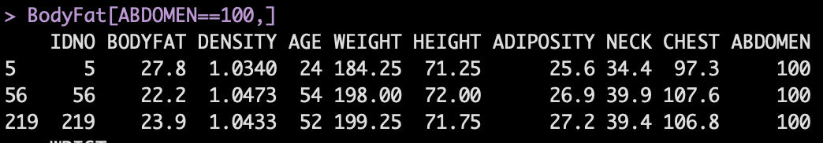
Testing the model
95% predict interval for 100 cm abdominal cirumference
Prediction: 23.597
Interval: (14.983, 32.211)
Actual data: 27.8, 22.2, 23.9

Slide 11
Evaluation of our model
Linearity: Seems reasonable. Not only visually convincing but also statistically significant.
Additivity: Reasonable in general. Body fat is additive as abdomen gets bigger.
Constant effects: Reasonable but may not. Because muscular man could have the same abdomen size
Fixed X: This seems reasonable for this data.
Notes:
Simple, Accurate, and Robust

Slide 12
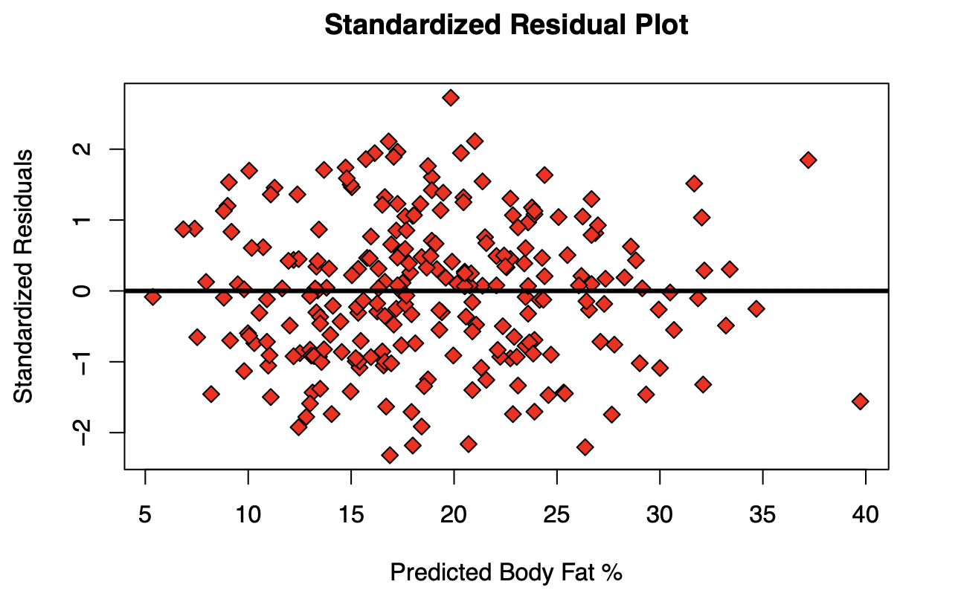
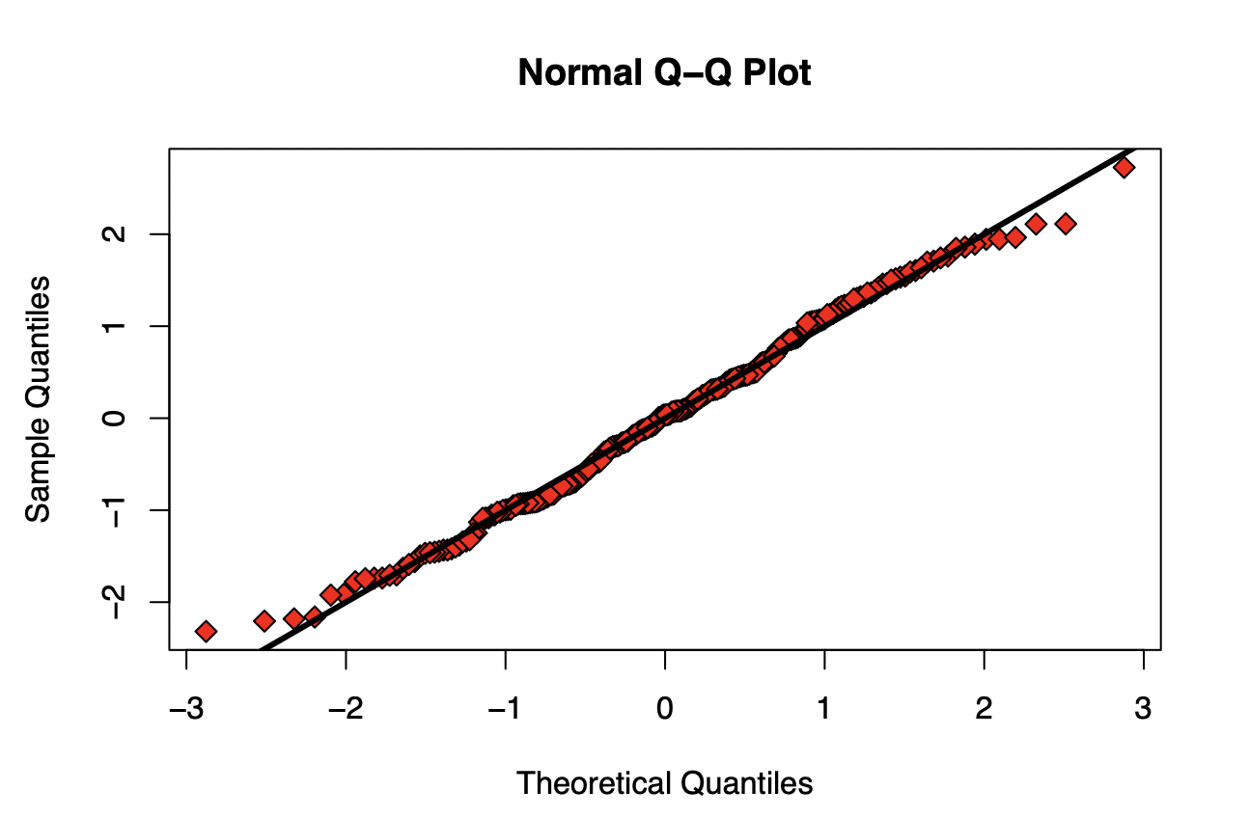
Normality Assumption
Notes:
The error term ϵi is distributed as Normally distributed.
The variance on the error terms is assumed to be constant (i.e. homoskedastic).

Slide 13
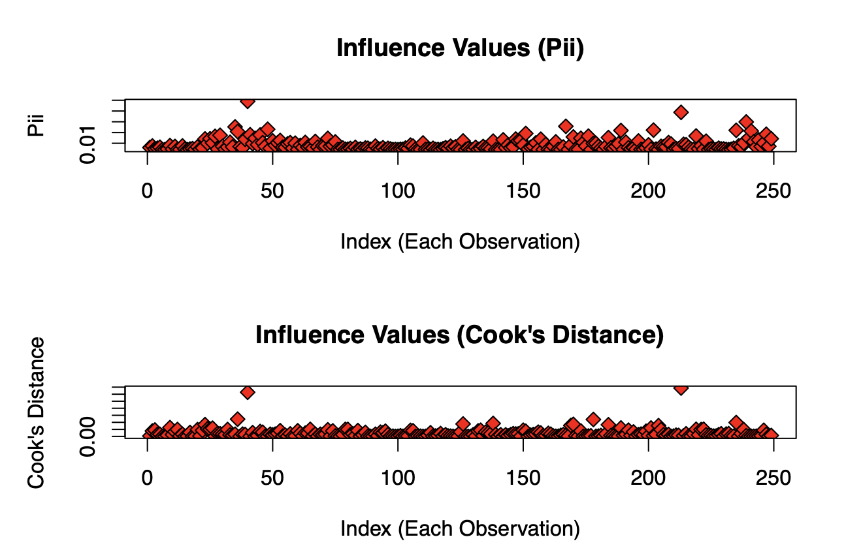
Leverage Points

Slide 14
Rule of Thumb
Body Fat % = -38 + 0.6 * Abdomen
Multiply your abdomen by 0.6 and subtract 38
For every 5 cm increase in abdomen size, a man would gain 1 % of body fat.
Caution: Our SLR model only explains 67% of variance and also only predicts for grown men. It could be inaccurate for women or children. 63cm (24 inches) = 0 body fat. 226cm (89 inches) 100 body fat.

Slide 15
Thank you!

